Slide 1
Journal Club
APIC Greater NY Chapter 13
Uthy Rajapakse, BSN, RN, CIC
February 7, 2024
Notes:
Welcome and self intro – Hello everyone. My name is Uthy and I am one of the Infection Preventionist at the Hospital for Special Surgery.

Slide 2
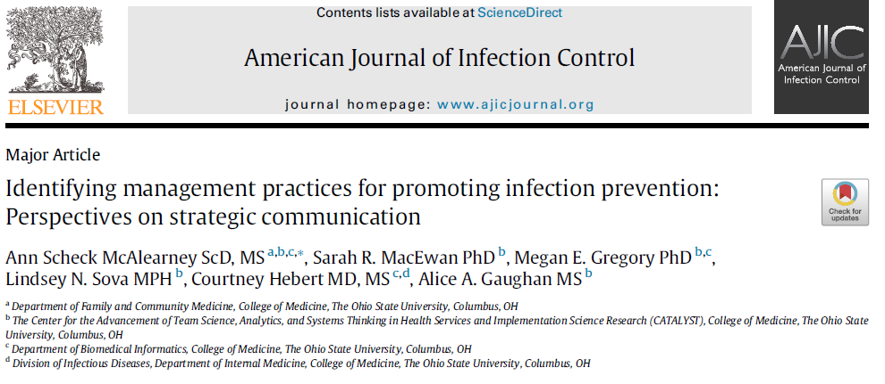
Article Overview
Title: Identifying management practices for promoting infection prevention: Perspectives on strategic communication
Authors: McAlearney et al
Publication: AJIC 2022 June; 50(6):593-597
Notes:
Article overview:
The article I picked for today’s journal club is titled: Identifying management practices for promoting infection prevention: Perspectives on strategic communication. This is an article written by McAlerney, et al. This was published in the June 2022 AJIC version 50, no. 6, from pages 593 through 597.
This article stood out for me because I am always looking for opportunities to improve my communication style when it comes to sharing HAI information with hospital leadership, unit leaders, and frontline staff; and sharing it in an impactful way where there are lessons learned from it as well as adding a “human factor”, so the patient doesn’t appear to be just a number on our HAI tracker. Harm reached an actual person possible from a flaw in our system. And how can we prevent them moving fwd.

Slide 3



Study Design
Setting: Site visits to 18 hospitals in the U.S. where 188 administrative and clinical leaders were interviewed between September 2017 – November 2019
Objective: identify and characterize strategic communication practices used by managers, directors, and executive leaders to share HAI prevention information
Inclusion: executive- and middle- level leaders in hospitals varying in size, region, and performance (based on 2016 HAI data from Hospital Compare)
x18
Notes:
Study Design: This was a cross-sectional study done in 18 hospitals throughout the U.S. where 188 admin and clinical leaders were interviewed, between Sept 2017 – Nov 2019.
It is not defined in the article, and I was not aware of what strategic communication actually meant, but what I gathered through this article is that it means beyond sharing meaningful information. I thought the article emphasized it as a thoughtful and purposeful approach to convey info in alignment with specific objectives.
And they say, although benefits of using strategic communication to IP is well documented, the strategies used by leaders to support successful info sharing is not well understood.
The objective of this study was to address this knowledge gap by identifying and characterizing strategic communication practices used by managers, directors, and executive leaders to share HAI prevention information.
The study included interviews of exec and mid level leaders in hospitals that varied in size, region, and performance.

Slide 4
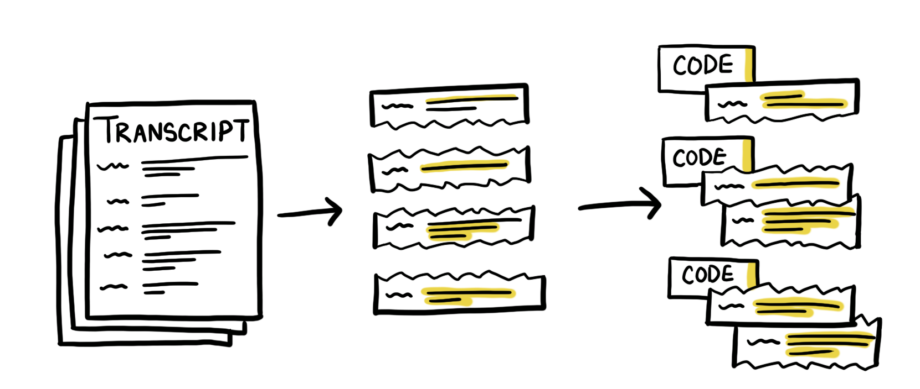
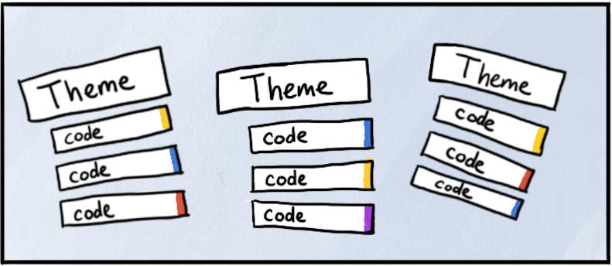
Methods
Participants: Using a purposive sampling approach hospitals were invited to participate in the study
  Geographic variability
  Varying organizational characteristics
  1- to 2-day site visits interviewing various leadership roles
Data Collection: A semi-structured interview guide was used to perform in-person 1:1 and group interviews
  Questions focused on management strategies for infection prevention
  Average interview time ~28 minutes
  Audio-recorded, transcribed verbatim, and de-identified.
Data Analysis: Rigorous qualitative research method
  Coded interview transcripts
  Integrated new codes as needed
Notes:
They chose participants using a purposive sampling approach where hospitals were invited to participate in the study
They ensured geographic variability by recruiting pairs of higher- and lower- performing hospitals within regions (based on 2016 HAI data from Hospital Compare)
They also included hospitals based organizational characteristics like the # of beds, ICU, teaching status
They spent 1- to 2-day at each site interviewing various leadership roles ranging from executives, directors, to managers (chief medical quality officer, chief of medical staff, chief nursing officer, managers of surgical, medical, and ICU units, clinical education, infection prevention, nursing quality, patient safety)
Data was collection using a semi-structured interview guide performing in-person 1:1 and group interviews
Questions focused on management strategies for infection prevention, particularly related to CLABSI and CAUTI prevention
Average interview took about ~28 minutes
Interviews were audio-recorded, transcribed verbatim, and de-identified.
Verbal informed consent obtained from all interviewees and Institutional Review Board approval from The Ohio State University
A rigorous qualitative research method was used for data analysis
The interview transcripts were coded
New codes were integrated as new themes emerged during analysis

Slide 5



Results
Strategic communication to support HAI prevention around 2 main topic areas
Facilitators of success and best practices in HAI prevention
  All my charge nurses are in there [hospital leadership meetings], and then we’re looking at ways that if somebody has been successful with something, or if they have a more efficient way of doing something. The charge nurses from that area can share what they are doing so the others can also look at if that’s applicable to their units or their teams. -Middle-level leader
Barriers to success and lessons learned in HAI prevention
  We take those things that we learned, lessons learned from that particular case, and then my boss emails the lessons learned out like in a bullet form, very simple bullet form, so that they can now incorporate that into their shift huddles for the next two weeks. All of the charge nurses on both campuses. -Middle-level leader
Notes:
Two things were highlighted in the results
One was that the study found 2 main topic areas around strategic communication to support HAI prevention
Facilitators of success and best practices in HAI prevention
Barriers to success and lessons learned in HAI prevention
This highlighted piece is an example of facilitators of success and best practices from an interview of a middle level leader who explain how the charge nurses (who are included in this particular leadership meeting), share success stories, like processes that works well for them, in a more efficient way maybe, so other charge nurses can see if these processes are applicable to their units and teams.
This next highlighted piece is an example of barriers to success and lessons learned from an interview of a mid level leader who explains how they take lessons learned from case reviews and share via email in simple bullet form so charge nurses can share them during shift huddles for the next two weeks

Slide 6
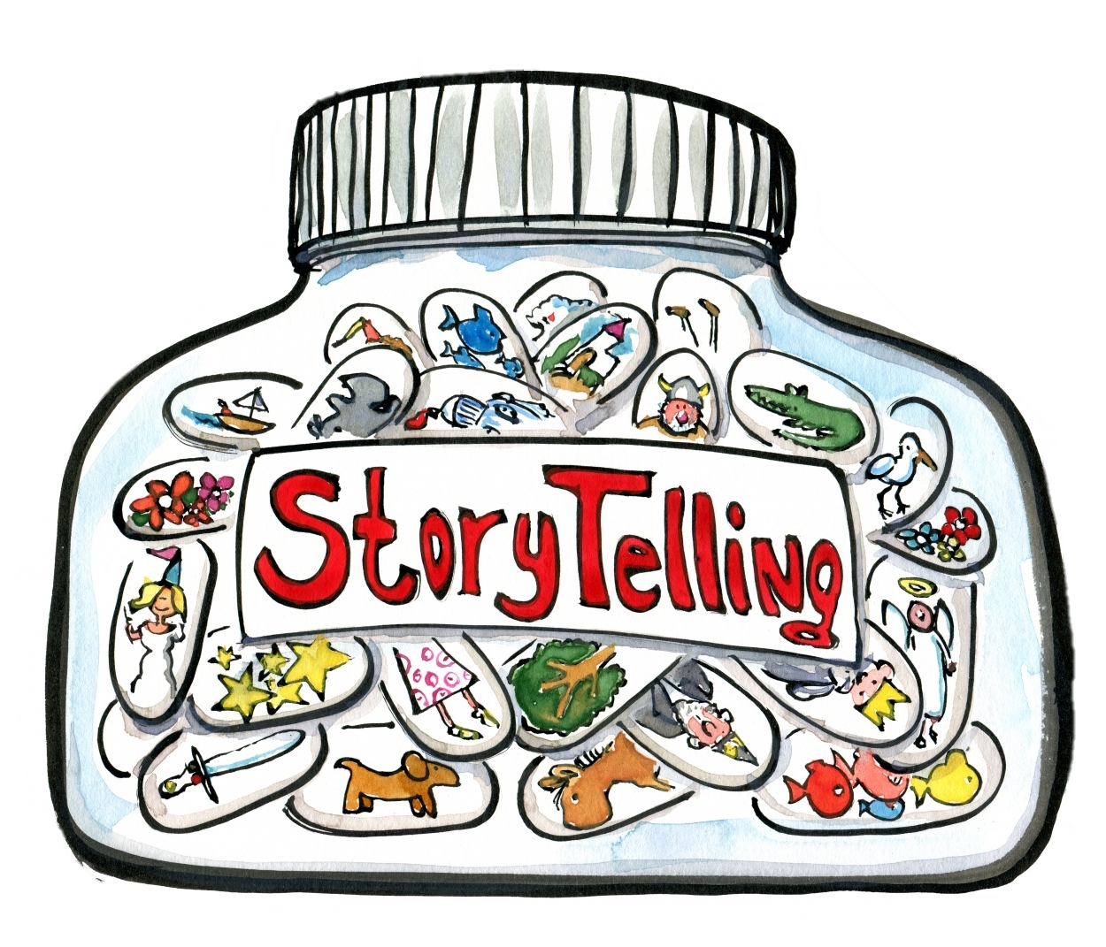



Results cont.
Storytelling as part of strategic communications to support HAI prevention
To create impact
  The most powerful presentation that I ever made to the board was when I put faces of−and they weren’t the actual patients−but I put the names of the patients and there was a face up there. And, you know, when you start showing that okay this person came in to have this procedure done. They had expected mortality which was two percent and they died. People start to get impressed. -Executive-level leader
To educate
  So, before we start the meeting, we talk about a safety story. So, whoever. It could be the EVS [Environmental Services] person’s [story]. It could be the respiratory person’s safety story. Whatever was done to prevent an event from happening to a patient. -Middle-level leader
To acknowledge success
  Every day we do a 10 AM safety huddle in person in the auditorium. And so, quality reports, and if there are any shout-outs of any kind, great catches are talked about there. -Middle-level leader
Notes:
The other topic that was highlighted in the results was storytelling as past of strategic communication to support HAI prevention.
Hospital leaders described 3 important reasons to utilize storytelling – to create impact, to educate, and to acknowledge success
To give us more time for discussion piece of this presentation I am going to summarize this piece…

Slide 7

Conclusions
Hospital leaders play a key role in infection prevention by sharing information in meaningful ways
Strategic communication can be used with:
  Content
  Approach
Notes:
The article concluded by confirming that:
By sharing information in meaningful ways, hospitals and their leaders can make strides in this important area as they strive to improve infection prevention efforts across the organization
Also, that strategic communication can be used to enhance HAI prevention efforts through both the content and approach of these communications

Slide 8
Discussion
Study limitations – Although they identified strategies used by organizations, it didn’t examine the effectiveness of them.
What are your thoughts on this study including both higher- and lower-performing institutions?
Are there any strategies from this study that you currently use in your practice as an IP (or your hospital leaders use to communicate HAI prevention within the organization)?
Are there strategies from this study that you can implement to your current practice of IP information sharing?

Slide 9

Thank you!
U.Rajapakse@gmail.com

Slide 10
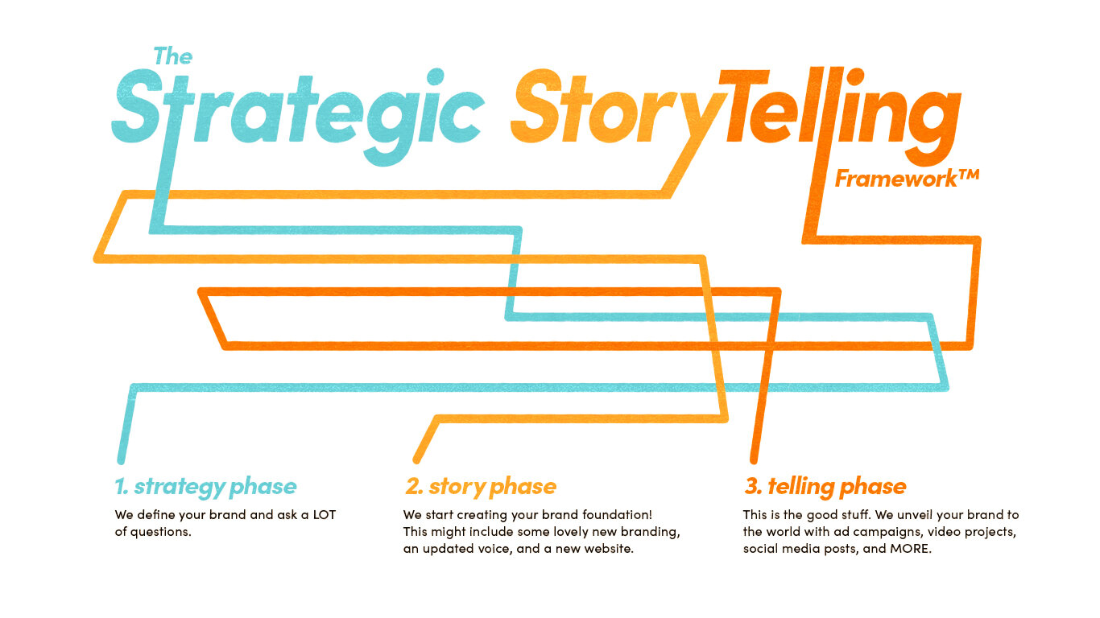

Clipart parking lot

